Slide 1

DELHI TECHNOLOGICAL UNIVERSITY
DEPARTMENT OF INFORMATION TECHNOLOGY
Title - CNN Based Deep Learning Method for Detecting Breast Cancer
IT - 402 - B.Tech Project - 2
Under Supervision of:
Prof. Kapil Sharma
Department of Information Technology
Submitted By:
Utkarsh (2K19/IT/136)
Varun Kumar (2K19/IT/140)
Yashit Kumar (2K19/IT/149)

Slide 2
ABSTRACT
Cancer remains one of the deadliest illnesses in the world, with almost 10 million deaths recorded in the last year alone. In India, breast cancer represents 14.7% of all cancer cases and is the main reason of cancer-related deaths.
Despite numerous studies on early breast cancer detection, a significant percentage of cases remain undiagnosed, with only about 86% of cases being identified correctly.
Convolutional Neural Networks (CNNs) were proposed in this study for breast cancer identification in order to reduce the costs associated with manual analysis since deep learning techniques are revolutionizing the area of medical image analysis

Slide 3
INTRODUCTION
Invasive Ductal Carcinoma (IDC) is the most common type of breast cancer. It's malicious and able to form metastases which makes it especially dangerous.
Often a biopsy is done to remove small tissue samples. Then a pathologist has to decide whether a patient has IDC, another type of breast cancer or is healthy. In addition, sick cells need to be located to find out how advanced the disease is and which grade should be assigned. This must be done manually and is a time-consuming process.

Slide 4
Continued
Furthermore, the decision depends on the expertise of the pathologist and his or her equipment.
Therefore deep learning could be of great help to automatically detect and locate tumour tissue cells and to speed up the process. In order to exploit the full potential, one could build a pipeline using massive amounts of tissue image data of various hospitals that were evaluated by different experts.
This way one would be able to overcome the dependence on the pathologist which would be especially useful in regions where no experts are available .

Slide 5
The Goal:
The goal is to make the work of the pathologist more efficient by quickly classifying if the given tissue is cancerous or not by passing it through the CNN model.
Using the model, the process can made very efficient as the as the model can be fed huge amounts of data in the range of thousands and classify each of the images in minutes which if done manually will take days to do so.

Slide 6
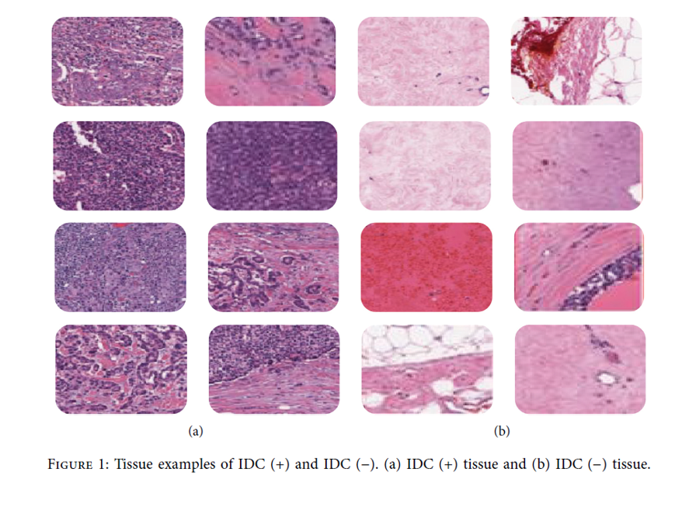

Slide 7
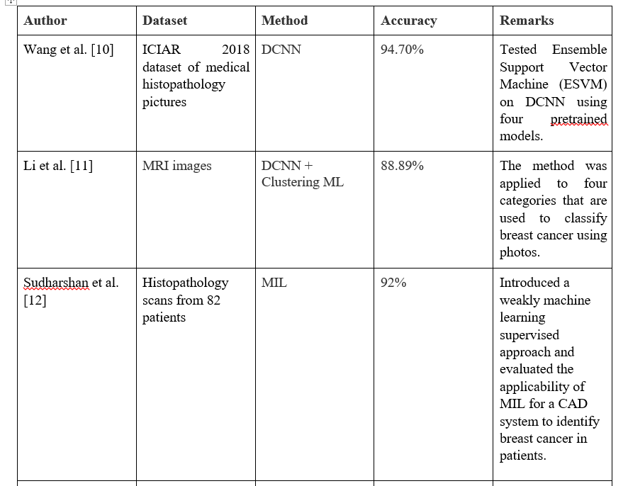
Related Work

Slide 8
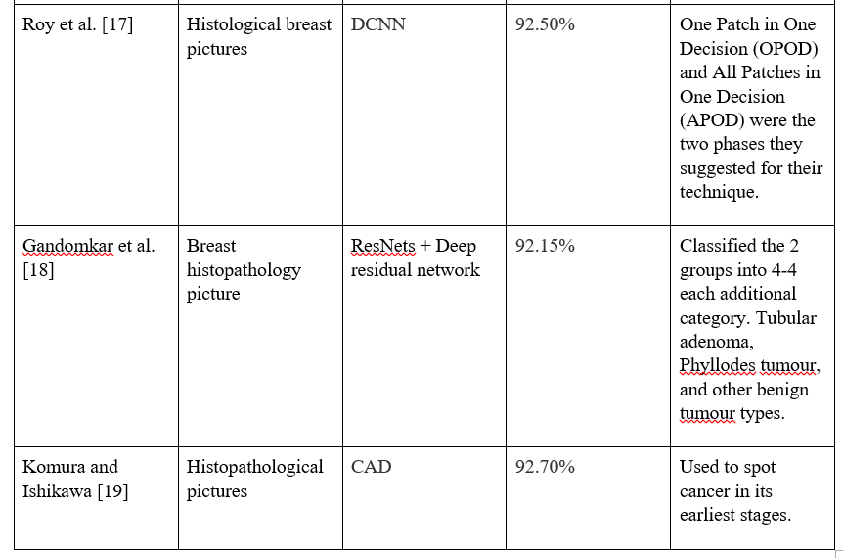

Slide 9
Deep
Learning Steps:
Exploring the Data
Creating the Dataset
Preprocessing
Building and Testing the model
Evaluating the Model

Slide 10
Dataset Used
Breast Histopathology Images
The original dataset consisted of 277,524 patches of size 50 x 50 were extracted (198,738 IDC negative and 78,786 IDC positive).
Each patch’s file name is of the format: uxXyYclassC.png — > example 10253idx5x1351y1101class0.png .
Where u is the patient ID (10253idx5), X is the x-coordinate of where this patch was cropped from, Y is the y-coordinate of where this patch was cropped from, and C indicates the class where 0 is non-IDC and 1 is IDC.

Slide 11
PROPOSED METHODOLOGY
A twenty two layer CNN architecture has been proposed by us, which gave outstanding results in identifying breast cancer. The diagram represented in Fig. 1 gives a brief description regarding how our proposed model has been implemented. We have first created a convolutional layer comprising of 32 convolutional filters, each having dimension 3*3, This first convolutional acts as input layer for the showcased model. The ReLU function is selected as activation function for this layer.
If the input value is positive, ReLU function will output value same as input value, else it outputs zero. Batch Normalization layer is applied after this convolutional layer. Batch Normalization is an approach through which neural networks are created quickly and additional stability is added by normalization of layers’ inputs. Another convolutional layer comprising 32 filters, each having dimension 3*3 is added. Next, a max pooling layer is added, in which a 2D filter is slid over every channel of feature map.
This helps in encapsulating fundamental characteristics of the area covered by filter. Also, the pooling layer diminishes the output shape, which in turn narrows down the number of parameters in the model defined. Since pooling layer encapsulates features, the additional computations will be performed on those encapsulated features instead of accurately determined features presented by the convolutional layer. The most critical characteristics of the input feature map will be the output of max pooling layer.

Slide 12
The max pooling layer is followed by another batch normalization layer which is further followed by a dropout layer with dropout ratio 0.3. Next, a convolutional layer that consists of 64 convolutional filters, each with a size of 3*3, using ReLU as the activation function. The second convolutional layer is coupled to a further batch normalization layer which is further followed by a max pooling layer and dropout layer similar to the previous ones. Another convolutional layer consisting of 128 convolutional filters each having dimensions 3*3 with activation function selected as ReLU is added next to the max pooling layer. A flatten layer is then added to flatten the 3D feature map obtained after performing convolutional, pooling and batch normalization functions on our input image, into a 1D dense layer. Five dense layers have been added in the showcased deep CNN architecture. The initial dense layer encompasses 128 neurons with activation function set to ReLU function. 64 neurons make up the second dense layer. The third dense layer encompasses 64 neurons with activation function again set to ReLU function. A dropout layer is attached after the third dense layer with dropout ratio 0.3. This is done to reduce overfitting in our proposed CNN architecture. The fourth dense layer encompasses 24 neurons with activation function again set to ReLU function. The last dense layer contains 2 neurons which give the final output as to whether the image contains breast cancer or not. The activation function in this dense layer is set to the Softmax function. Then the model is trained for 40 epochs with the Adam optimizer and loss as binary cross entropy as we are classifying binary inputs and learning rate of 0.0001.

Slide 13
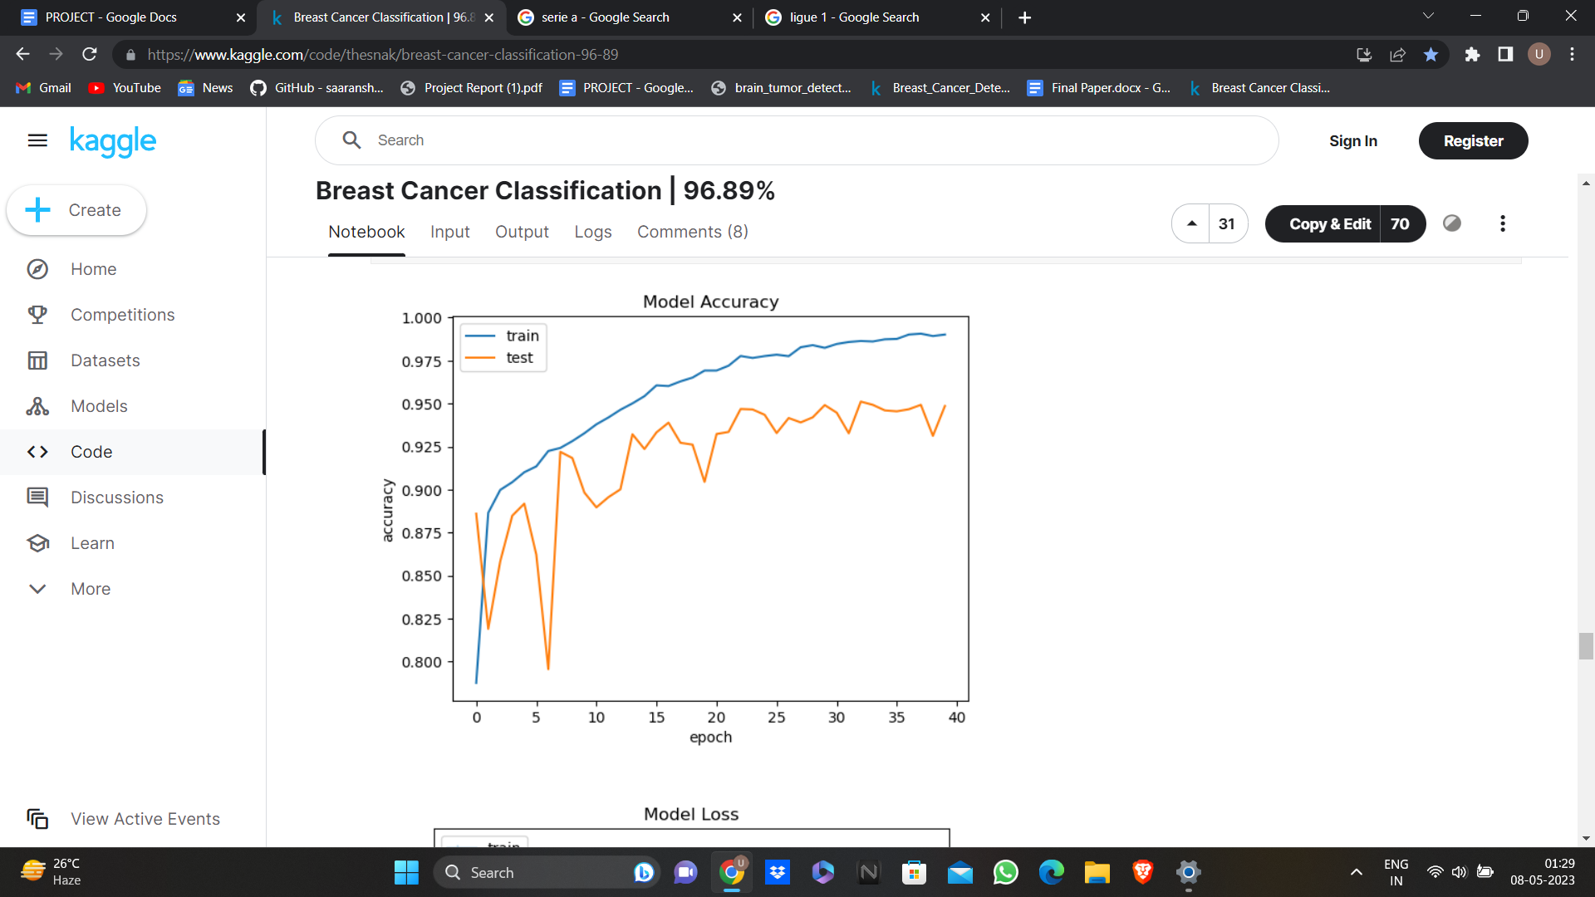
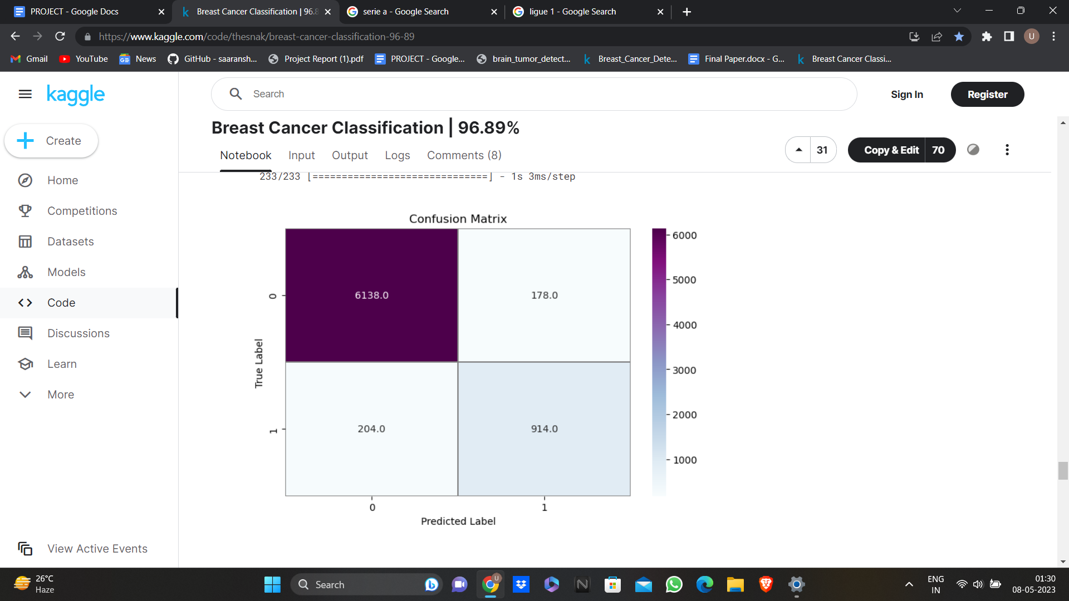
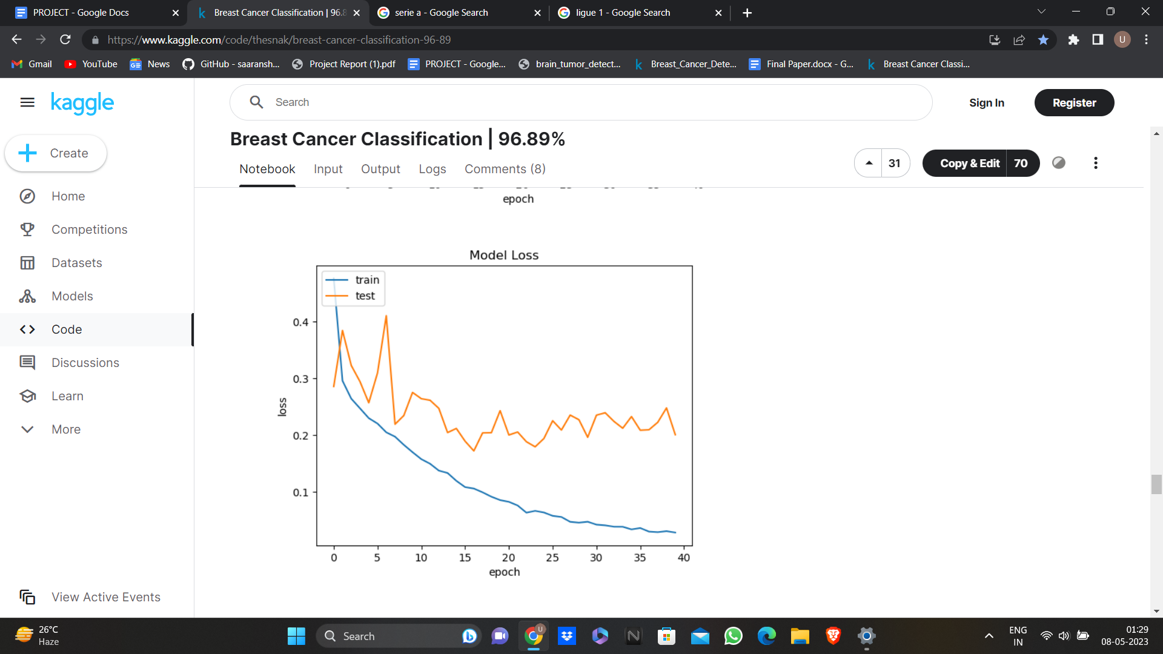
Evaluating the Model

Slide 14
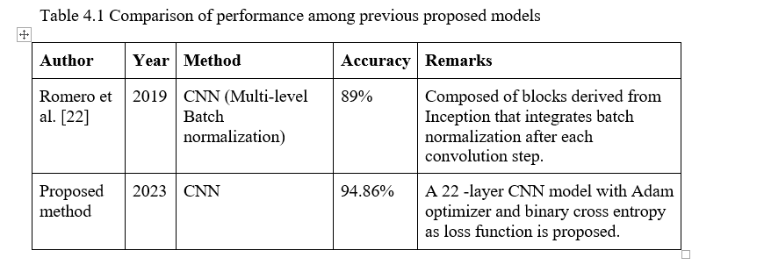
The showcased model attained a 81.76% recall, 94.86% accuracy, 82.71% F1 score, 83.70% precision.

Slide 15
Conclusion
We evaluate our suggested model using a dataset of 277,524 patches. With a 40-epoch strategy, Our CNN model includes 22 layers. To reach our final result, we used 30% of the images as testing data and 70% of the images as training data. The proposed model has a 94.86% overall accuracy in detecting cancers from photos. The proposed approach may be seen as a computer-aided automated detection tool for precisely identifying breast abnormalities in histopathology data.The model might be enhanced. The model's output for current recall is adequate. The recall may be further enhanced for application in the actual world. Pathologists can find cancer on tissue more quickly thanks to this model. Examining tissue slides by hand would not be necessary.

Slide 16
Future Scope and work to do
The data set used is relatively smaller in size compared to what we can have for more accurate results. For the future scope we will use newer and well updated dataset which will give us more accurate results and be able to detect the other variety of cancerous tissues.
We also used fewer algorithms, for future scope we are going to use more and updated deep learning algorithms to obtain better results and compare them.
Deeper architectures, as well as ultrasound, histopathology, and PET imaging, will be used in the future to address difficulties created by mammography of dense breasts. Other imaging modalities should be used in conjunction with mammography during the learning process to assist develop a robust breast mass predictor.

Slide 17
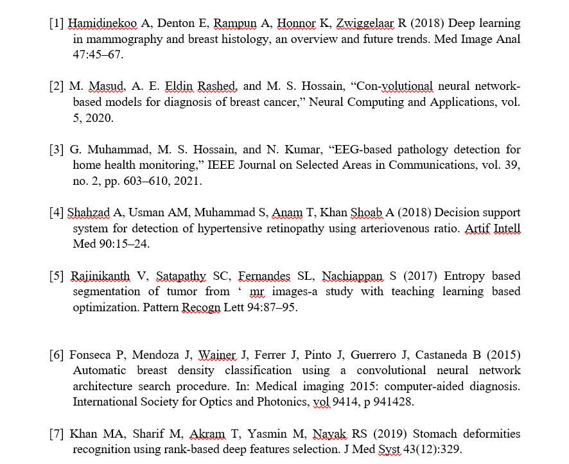
References

Slide 18
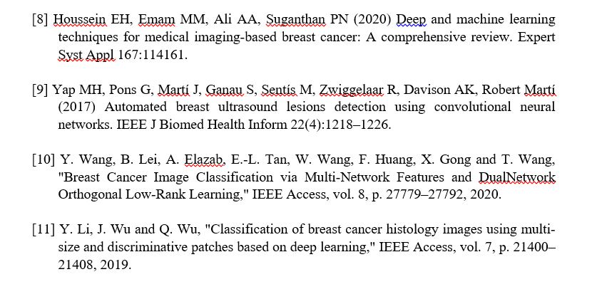

Slide 19


